Slide 1
OneSchool
Team Online 5 : The Liberators
By:
Fang Guo
Yuanying Li
Kunj Mithapara
Yuxuan Qi
Vipul Suresh

Slide 2
CUSTOMER SEGMENTS
Teachers
Students
Administrators
Training
Knowledge development
Collaboration
Peer to Peer Interaction
Knowledge development
Extra-Curricular
Operational improvements
Access Control
Collaboration

Slide 3
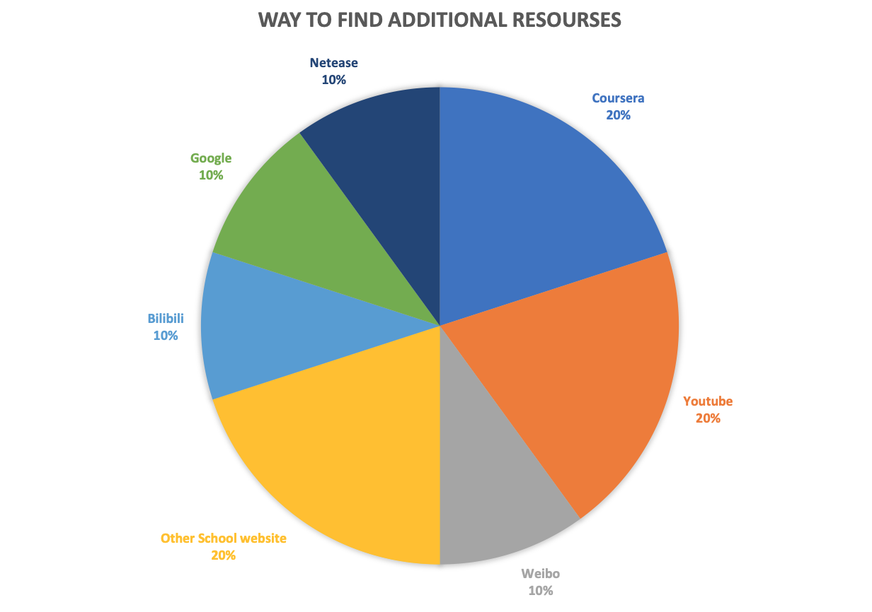
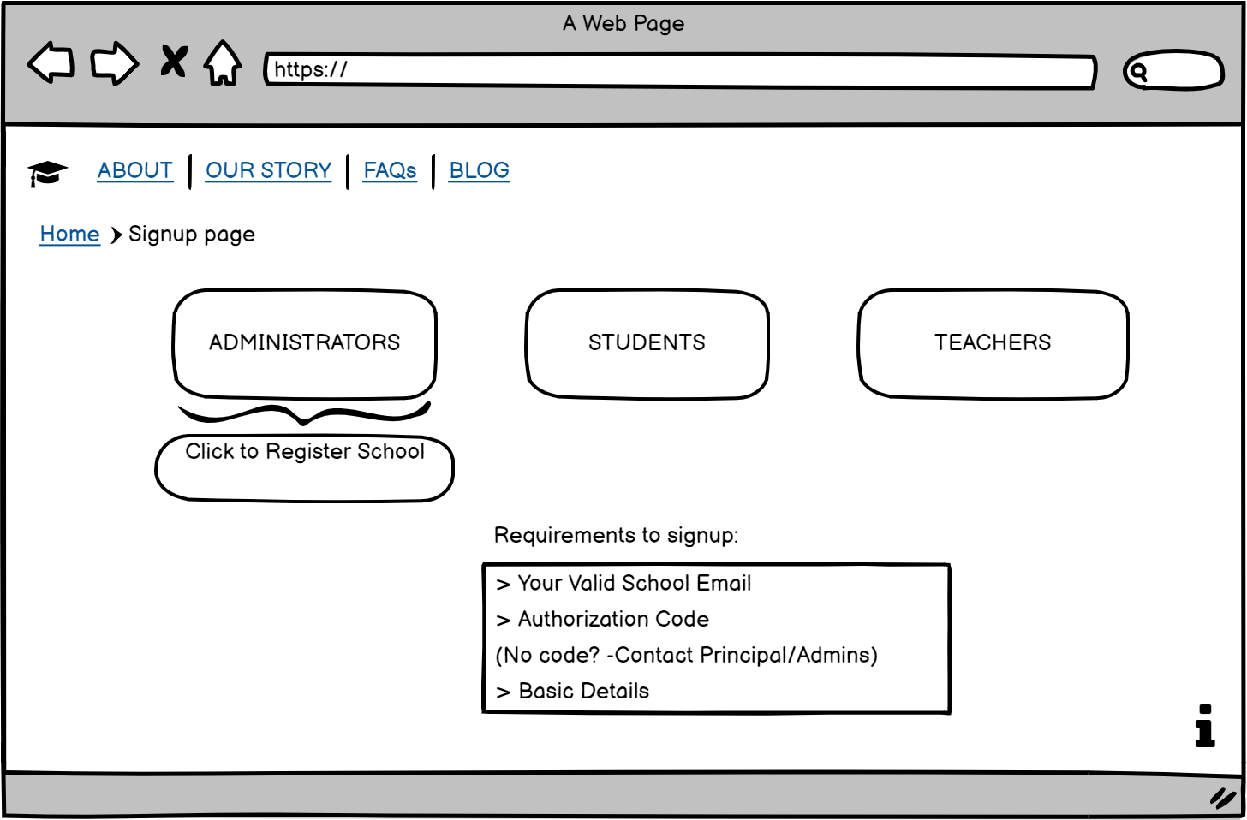
PROPOSED SOLUTION
“An App which removes barriers to these temples of knowledge that have been set up based on borders, race, and religion and brings all institutions into just One School”

Slide 4
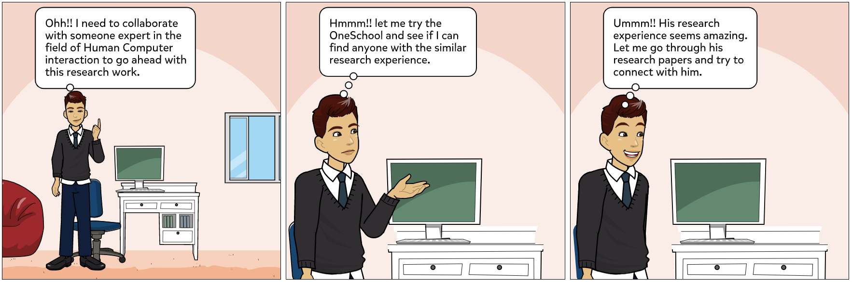
VISUAL STORYBOARD

Slide 5
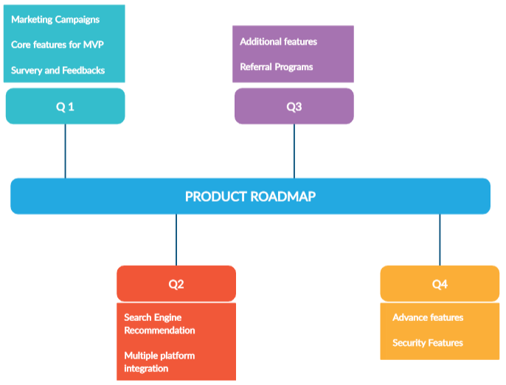
PRODUCT ROADMAP

Slide 6
PRODUCT FEATURES
Common
Chat Translator
Chatbot
Profile Courses
Gender
Designation
Interest
Skill
Student
Projects/Courses: Search
Check detail
Join
Dashboard: Activities or Performance
Teacher
Coursework/Teachers: Search
Check detail
Connect
File Collection: Store or Publish
File Synchronize
Administrator
List of contacts Notification
Post Activity

Slide 7
MINIMUM VIABLE PRODUCT
Common
Chat Translator
Chatbot
Profile Courses
Gender
Designation
Interest
Skill
Student
Projects/Courses: Search
Check detail
Join
Dashboard: Activities or Perform
Teacher
Courseware/Teachers: Search
Check detail
Connect
File Collection: Store or Publish
File Synchronize
Administrator
List of contacts Notification
Post Activity

Slide 8



METRICS
Quantitative Metrics
Qualitative Metrics
User retention (Top1)
Pay rate (Top2)
Number of new users per month (Top3)
Active users’ number per month
Number of posts
Number of teaching resources
Number of new users per month
Top landing pages
Top exit pages
Location of visitors.
Notes:
Product metrics are quantifiable data points that help us tracks and analyzes to gauge the success of our product.
Here list the metrics we would use to OneSchool.
The top 3 we want to focus the most are : User retention, Pay rat, Number of new users per month

Slide 9




OPERATIONAL NEEDS
Application Development
Marketing
Legal
Student Feedback
Notes:
For the function of OneSchool application, we need support from many areas:
Application development: After we officially released OneSchool application, software engineers need to maintain the application.
For example, Marketing team also need some marketing campaign to attract more users
For leges need, We also should comply with privacy protection law to store student information securely.
Finally, Communicate directly with users, get feedback, help improve the drawbacks of the existing functions of application.

Slide 10

PROJECTED COST
$ 11,05,000
12 person/month
19 person*month
Total time for development
Total time for development,testing and design

Slide 11
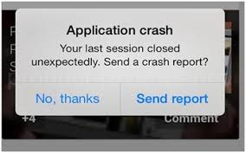



ADDRESSING RISKS
Data Privacy
App Crashes
Institutional Collaboration
Internet Issues

